Slide 1

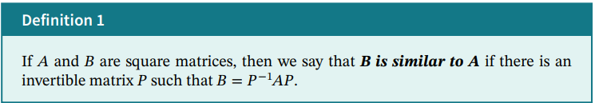
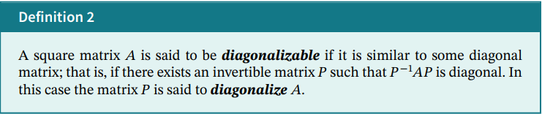
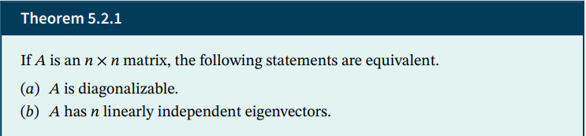

Slide 2
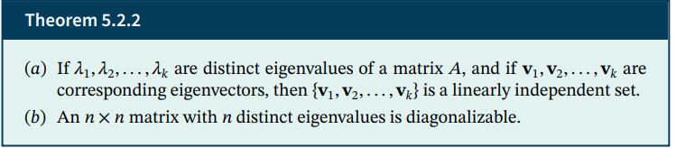
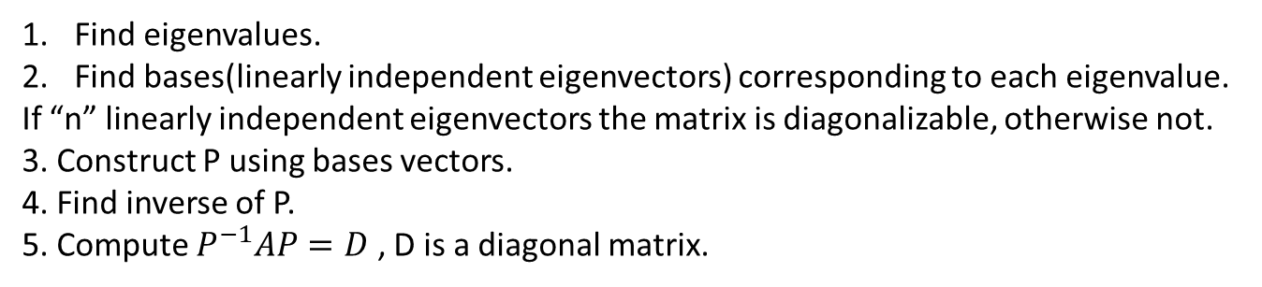
Find eigenvalues.
Find bases(linearly independent eigenvectors) corresponding to each eigenvalue.
If “n” linearly independent eigenvectors the matrix is diagonalizable, otherwise not.
3. Construct P using bases vectors.
4. Find inverse of P.
5. Compute $P^{−1}AP=D$ , D is a diagonal matrix.

Slide 3
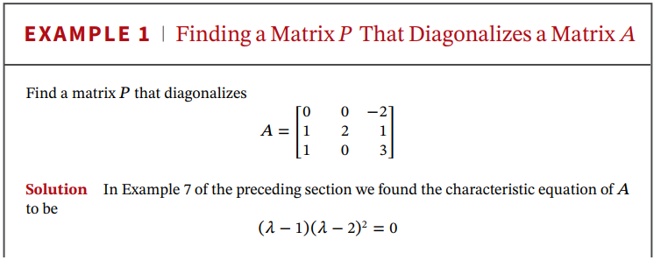
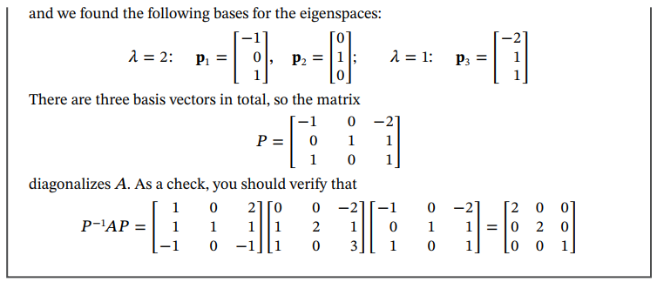

Slide 4
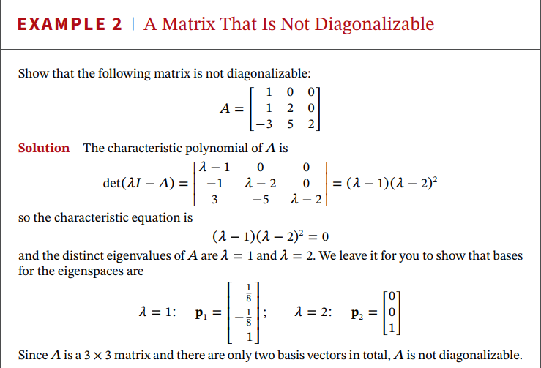

Slide 5
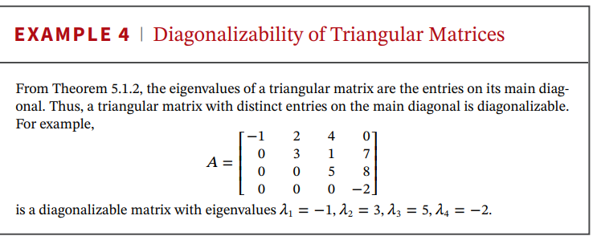

Slide 6
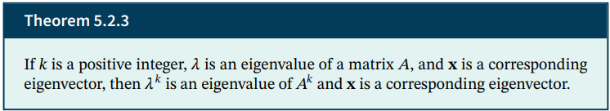
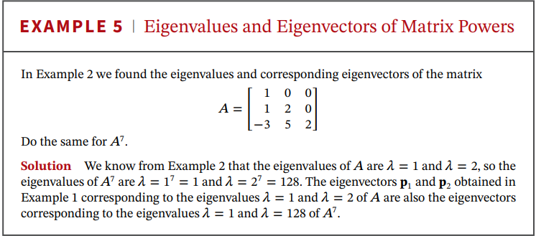

Slide 7

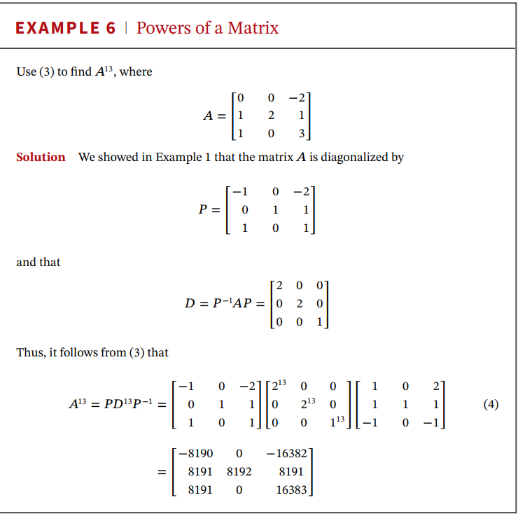
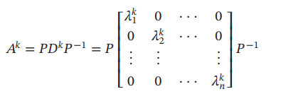

Slide 8



Algebraic multiplicity: Number of times an eigenvalue appears as a root of characteristic equation of a matrix.
Geometric multiplicity: Dimension of eigenspace corresponding to eigenvalue.
If 𝐴 is a square matrix, then for each eigenvalue $λ$
a. Geometric multiplicity $≤$algebraic multiplicity.
b. A is diagonalizable iff algebraic and geometric multiplicities are equal for all eigenvalues.

